Slide 1
Databases with R: A Marriage Made in the Tidyverse
Patrick Mathias

Slide 2
Goals and Objectives
Connect to and explore the tables of a database using the DBI package
Apply dplyr functions to extract and manipulate data from a database
Visualize and summarize data within a database

Slide 3
Connecting with Relational Databases
DBI package provides functions to connect to and perform operations on DBs
odbc package utilizes Open Database Connectivity (ODBC) drivers to connect with various types of SQL databases
RSQLite package houses driver information specific to SQLite connections

Slide 4
Exercise 1
Run the setup chunk to load the packages we need to connect to databases

Slide 5
First Step: Connect to a Database
connection object
driver
con_name <- dbConnect(drv = driver_function,
…)
additional connection options (file, user, pass, etc.)

Slide 6
Connect to a SQLite Database
connection object
driver
con_name <- dbConnect(drv = RSQLite::SQLite(),
dbname = “file_name.db”)
file to connect to
(writes file if it doesn’t exist)
https://rsqlite.r-dbi.org/reference/sqlite

Slide 7
Preserving dates and Times Requires an Additional Argument
connection object
driver
con_name <- dbConnect(drv = RSQLite::SQLite(),
dbname = “file_name.db”,
extended_types = TRUE)
argument to preserve date and time formatting
https://rsqlite.r-dbi.org/reference/sqlite

Slide 8
Disconnect from the database when not Actively Using It
active connection object
dbDisconnect(connection_object)

Slide 9
Exercise 2
Connect to MIMIC database by building a connection object named "mimic". How can you confirm you are connected?
List the tables in the mimic database.
List fields from LABEVENTS and D_LABITEMS

Slide 11
Exercise 3
Reopen the connection to the mimic SQLite database (you can use the original code to establish the connection from Exercise 1). Then enable the view of the database in the Connections pane and use the pane to answer how many dimension tables are included in the database.

Slide 12
Accessing Databases and Tables
Connection object contains information to connect with database
Database and tables NOT in memory/in R environment without additional steps
When data manipulation functions are run on database connection objects, R builds database queries without executing
When a function that requires data output is run, query will be executed
Simple function to confirm data: head will retrieve first rows in table

Slide 13
Connect to a Specific Table
database connection object
equivalent to data frame
table_object <- tbl(connection_object,
“table_name”)
database table to query

Slide 14
Connect to a Specific Table
database connection object
equivalent to data frame
batch_sql <- tbl(projectdb, "batch")
database table to query

Slide 15
The DPLYR Package supports a wide range of data manipulation activities
ƒ(
)
ƒ(
)
ƒ(
)

Slide 16
The Select() Function ACts Like the Select Operator for Databases
Extract specific columns/variables
= Number of rows
↓ Number of Columns

Slide 17
Select Captures Specific Variables
select(batch_sql, batch_name, reviewer_name)
name(s) of columns to extract
(or a select helper) function)
data frame to transform
data frame to transform

Slide 18
Select Captures Specific Variables
table connection object
sample_subset <- select(sample_sql,
batch_name, sample_name, compound_name, sample_type, ion_ratio)
name(s) of columns to extract

Slide 19
Select Captures Specific Variables
select(batch_sql, -batch_name, -reviewer_name)
Adding “-” drops variables rather than includes them

Slide 20
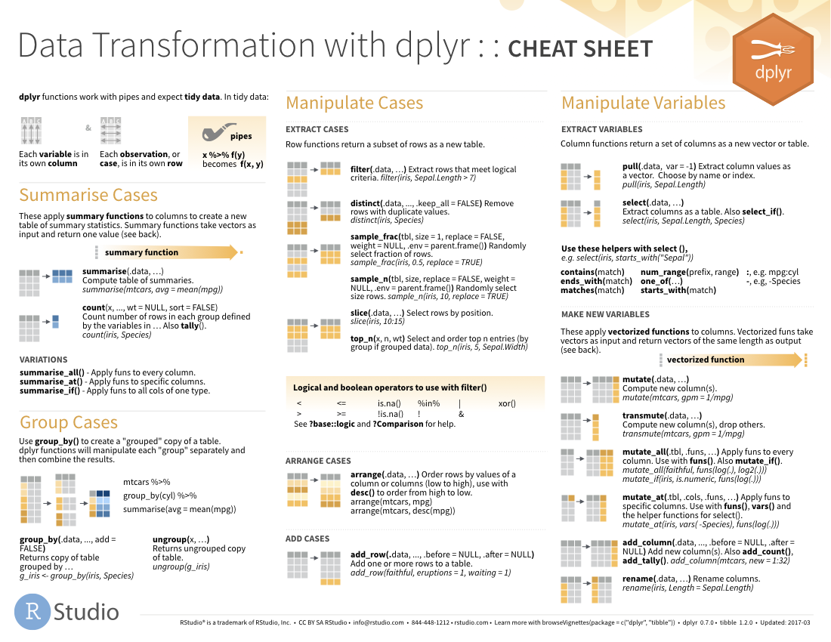
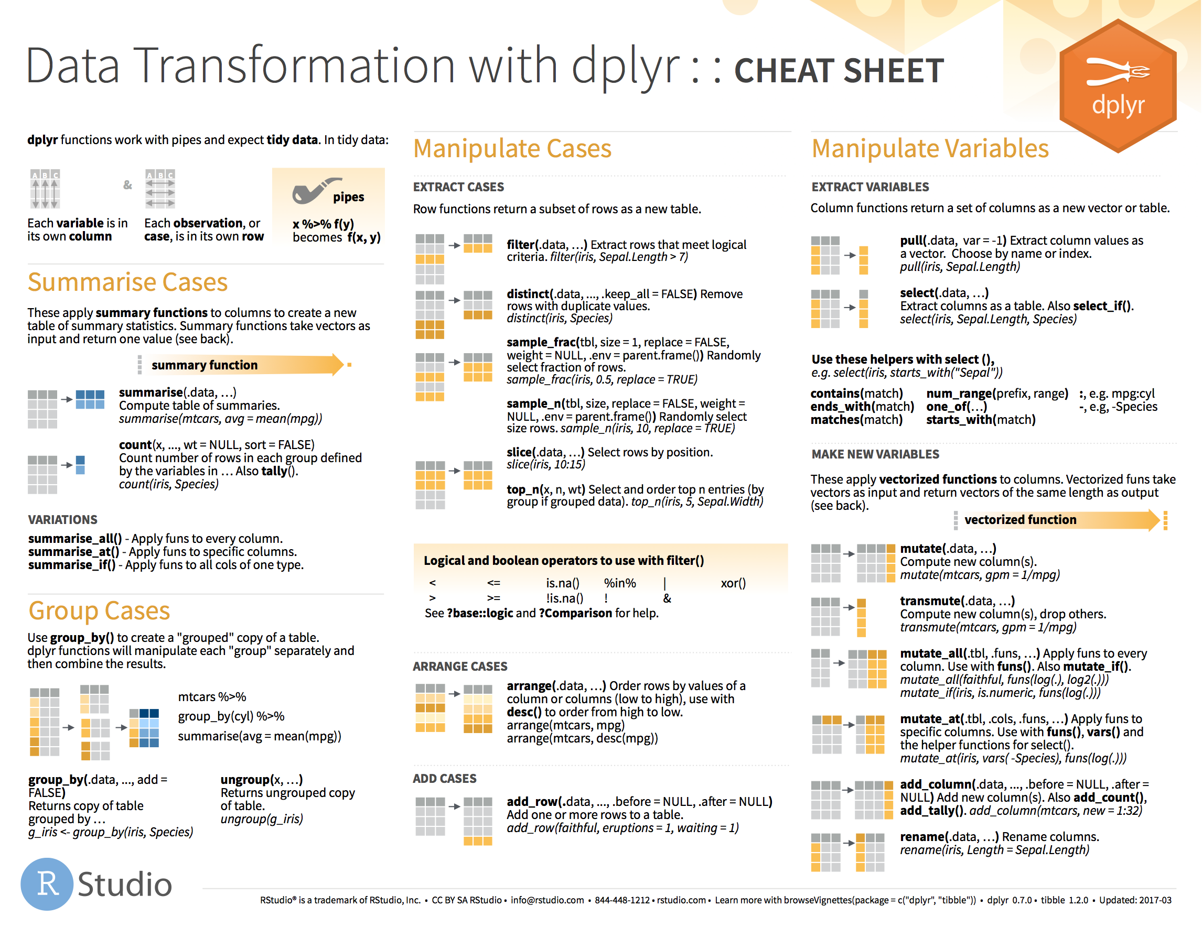
Helper Functions Support Complex Selections
20

Slide 21
The Filter() Function Acts Like a Where Clause in a SQL Statement
↓ Number of rows
= Number of Columns
Extract rows that meet logical criteria

Slide 22
Filter Captures Specific Rows
filter(data,... )
one or more logical tests (filter returns each row for which the test is TRUE)
data frame to transform
 |  |  | FALSE
 |  |  | FALSE
 |  |  | TRUE
 |  |  | FALSE
 |  |  | TRUE
 |  |  | FALSE

Slide 23
Filter Captures Specific Rows
filter(data, column_name == criteria )
one or more logical tests (filter returns each row for which the test is TRUE)
 |  |  | FALSE
 |  |  | FALSE
 |  |  | TRUE
 |  |  | FALSE
 |  |  | TRUE
 |  |  | FALSE

Slide 24
Filter Captures Specific Rows
filter(batch_sql, compound == “morphine”)
batch_name | Instrument_name | compound_name
b802253 | doc | hydromorphone
b802253 | doc | codeine
b802253 | doc | hydrocodone
b802253 | doc | morphine
batch_name | Instrument_name | compound_name
b802253 | doc | morphine
FALSE
FALSE
FALSE
TRUE

Slide 25
Filter Captures Specific Rows
Values coded as character strings must be surrounded by quotes
filter(batch_sql, compound == “morphine”)
batch_name | Instrument_name | compound_name
b802253 | doc | hydromorphone
b802253 | doc | codeine
b802253 | doc | hydrocodone
b802253 | doc | morphine
= sets
(returns nothing)
== tests if equal
(returns TRUE or FALSE)
FALSE
FALSE
FALSE
TRUE

Slide 26
Logical Tests Commonly Used with Filter()
x < y | Less than
x > y | Greater than
x == y | Equal to
x <= y | Less than or equal to
x >= y | Greater than or equal to
x != y | Not equal to
x %in% y | Group membership
is.na(x) | Is NA
!is.na(x) | Is not NA

Slide 27
The Pipe (|> ) Helps Organize Sequential Data Manipulation Activities
sample
|>
filter(____, concentration > 0)
filter(sample, concentration > 0)
sample |> filter(concentration > 0)

Slide 28
The Pipe (|> ) Helps Organize Sequential Data Manipulation Activities
sample_subset <- sample_sql |>
filter(sample_type == "standard") |>
select(sample_name, compound_name, concentration,
expected_concentration)
Sequence filter() and select() to create a subset of the data

Slide 29
DB Connections and Memory Management
Connection objects in R are NOT data frames but contain the query to retrieve the relevant data
Allow transformation and analysis of data without using memory
Data can be brought into environment as a data frame using connect() function

Slide 30
Collect() will retrieve data into a data frame
sample_subset <- sample_sql |>
filter(sample_type == "unknown", compound_name == "oxycodone") |>
select(batch_name, sample_name, compound_name, sample_type, concentration) |>
collect()
dplyr functions don’t inherently retrieve data

